Slide 1
Notes on General Purpose IO (GPIO) and Interrupts

Slide 2
Basic Concepts
Depending on the switch position, one of the LEDs lights up.
Green
Yellow
Goal: light either LED1 or LED2 based on switch SW1 position
GPIO = General-purpose input and output (digital)
Input: program can determine if input signal is a 1 or a 0
Output: program can set output to 1 or 0
Can use this to interface with external devices
Input: switch
Output: LEDs

Slide 3
Steps to program the GPIO
1- Set the clock for PORTA
KL25Z sub-family reference manual: Page 206.
SIM module, register SCGC5, bit 9 activates clock for PORTA.
SCGC5 register is at address 40048038h.
SIM->SCGC5 |= SIM_SCGC5_PORTA_MASK;
2- Select bits 5, 13, 19 of PORTA as GPIO
KL25Z sub-family reference manual: Page 183.
PORT control module, port A, registers PCR[5], PCR[13], PCR[19]
PTA-PCR[5] at address 40049014h, PTA-PCR[13] at address 40049034h, PTA-PCR[19] at address 4004904Ch.
Set the MUX value (bits 10,9,8) to 1 for each PCR
Slide 18: Pin Control Register (PCR) layaout
Slide 19: PORT type data structure that contains 32 PCR registers.
Slide 20: Binds PORT to physical address.
3- Select bit 5 as Input, and bits 13 and 19 as outputs
KL25Z sub-family reference manual: Page 775.
GPIO module, PORTA, registers PDOR at address 400FF000h, PDIR at address 400FF010h, PDDR at address 400FF014h
In PDDR set bit 5 as 0, and set bits 13 1nd 19 as 1.
Bit 5 of PDIR shows the switch status. Write to bits 13 and 19 of PDOR to turn the LEDs on or off.
Slide 11: GPIO data structure that contains PDDR, PDIR, and PDOR.
Slide 12: Binds GPIO to physical address

Slide 4
2- Select bits 5, 13, 19 of PORTA as GPIO
KL25Z sub-family reference manual: Page 183.
PORT control module, port A, registers PCR[5], PCR[13], PCR[19]
PTA-PCR[5] at address 40049014h, PTA-PCR[13] at address 40049034h, PTA-PCR[19] at address 4004904Ch.
Set the MUX value (bits 10,9,8) to 1 for each PCR
Slide 18: Pin Control Register (PCR) layaout
Slide 19: PORT type data structure that contains 32 PCR registers.
Slide 20: Binds PORT to physical address.
#define LED1_POS (13)
#define LED2_POS (19)
#define SW1_POS (5)
// Make 3 pins GPIO
PORTA->PCR[LED1_POS] &= ~PORT_PCR_MUX_MASK;
PORTA->PCR[LED1_POS] |= PORT_PCR_MUX(1);
PORTA->PCR[LED2_POS] &= ~PORT_PCR_MUX_MASK;
PORTA->PCR[LED2_POS] |= PORT_PCR_MUX(1);
PORTA->PCR[SW1_POS] &= ~PORT_PCR_MUX_MASK;
PORTA->PCR[SW1_POS] |= PORT_PCR_MUX(1);
PORT_PCR_MUX(x) is a macro that fills the MUX position in the PCR with x value

Slide 5
3- Select bit 5 as Input, and bits 13 and 19 as outputs
KL25Z sub-family reference manual: Page 775.
GPIO module, PORTA, registers PDOR at address 400FF000h, PDIR at address 400FF010h, PDDR at address 400FF014h
In PDDR set bit 5 as 0, and set bits 13 1nd 19 as 1.
Bit 5 of PDIR shows the switch status. Write to bits 13 and 19 of PDOR to turn the LEDs on or off.
PTA->PDDR |= MASK(LED1_POS) | MASK (LED2_POS); // set LED bits to outputs
PTA->PDDR &= ~MASK(SW1_POS); // clear Switch bit to input
PTA->PDOR = MASK(LED2_POS); // turn on LED1, turn off LED2
while (1) {
if (PTA->PDIR & MASK(SW1_POS)) {
// switch is not pressed, then light LED 2
PTA->PDOR = MASK(LED2_POS);
} else {
// switch is pressed, so light LED 1
PTA->PDOR = MASK(LED1_POS);
}
}
MASK(x) is a macro that sets the position x within a 32 bit binary number to 1.

Slide 6
“mbed.h”
Enabling and Disabling interrupts:
__disable_irq(); // Disable Interrupts
__enable_irq(); // Enable Interrupts
Enable and Disable Pin interrupts:
InterruptIn interrupt_pin(SW2);
Interrupt_pin.rise(&flip); // Enable interrupt. Attach
// the address of the flip function to the rising edge
interrupt_pin.rise(NULL); // Disable interrupt.
Set Priority for interrupts:
NVIC_SetPriority(PORTD_IRQn, 128);

Slide 7
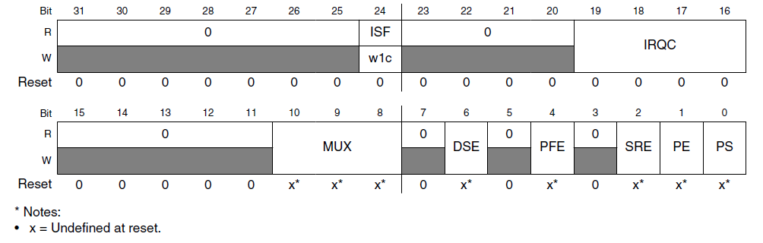
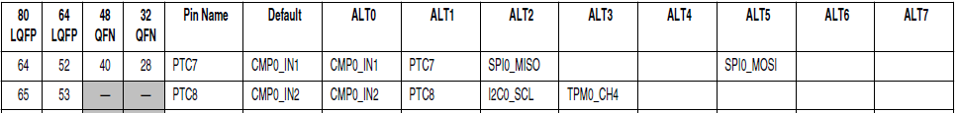
Pin Control Register
IRQC | Configuration
0000 | Interrupt Disabled
…. | DMA, reserved
1000 | Interrupt when logic zero
1001 | Interrupt on rising edge
1010 | Interrupt on falling edge
1011 | Interrupt on either edge
1100 | Interrupt when logic one
… | reserved
MUX (bits 10-8) | Configuration
000 | Pin disabled (analog)
001 | Alternative 1 – GPIO
010 | Alternative 2
011 | Alternative 3
100 | Alternative 4
101 | Alternative 5
110 | Alternative 6
111 | Alternative 7
MUX field of PCR defines connections

Slide 8
Refresher: Program Requirements & Design
RGB LED
ISR
Main
SW
count
(does initialization,
then updates LED based on count)
ISR
Task
Global Variable
Req1: When Switch SW is pressed, ISR will increment count variable
Req2: Main code will light LEDs according to count value in binary sequence (Blue: 4, Green: 2, Red: 1)
Req3: Main code will toggle its debug line DBG_MAIN each time it executes
Req4: ISR will raise its debug line DBG_ISR (and lower main’s debug line DBG_MAIN) whenever it is executing

Slide 9
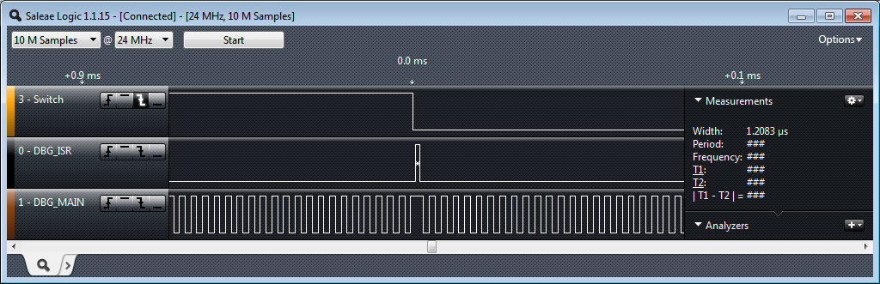
Visualizing the Timing of Processor Activities
Indicate CPU activity by controlling debug output signals (GPIO)
Monitor these with a logic analyzer (e.g. http://www.saleae.com/logic) or oscilloscope

Slide 10
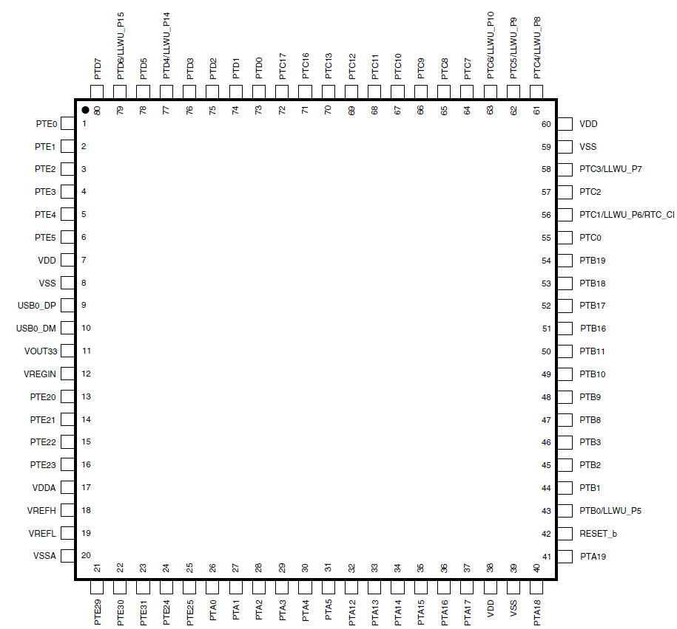
KL25Z GPIO Ports with Interrupts
Port A (PTA) through Port E (PTE)
Not all port bits are available (package-dependent)
Ports A and D support interrupts

Slide 11
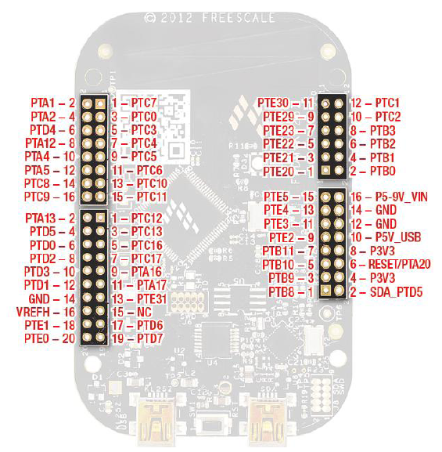
FREEDOM KL25Z Physical Set-up
DBG_Main
DBG_ISR
Ground
Switch Input

Slide 12
Main Function
int main (void) {
init_switch();
init_RGB_LEDs();
init_debug_signals();
__enable_irq();
while (1) {
DEBUG_PORT->PTOR = MASK(DBG_MAIN_POS);
control_RGB_LEDs(count&1, count&2, count&4);
}
}

Slide 13
Switch Interrupt Initialization
volatile unsigned count=0;
void init_switch(void) {
/* enable clock for port D */
SIM->SCGC5 |= SIM_SCGC5_PORTD_MASK;
/* Select GPIO and enable pull-up resistors and
interrupts on falling edges for pin connected to switch */
PORTD->PCR[SW_POS] |= PORT_PCR_MUX(1) |
PORT_PCR_PS_MASK | PORT_PCR_PE_MASK | PORT_PCR_IRQC(0x0a);
/* Set port D switch bit to inputs */
PTD->PDDR &= ~MASK(SW_POS);
/* Enable Interrupts */
NVIC_SetPriority(PORTD_IRQn, 128);
NVIC_ClearPendingIRQ(PORTD_IRQn);
NVIC_EnableIRQ(PORTD_IRQn);
}

Slide 14
ISR
void PORTD_IRQHandler(void) {
DEBUG_PORT->PSOR = MASK(DBG_ISR_POS);
// clear pending interrupts
NVIC_ClearPendingIRQ(PORTD_IRQn);
if ((PORTD->ISFR & MASK(SW_POS))) {
count++;
}
// clear status flags
PORTD->ISFR = 0xffffffff;
DEBUG_PORT->PCOR = MASK(DBG_ISR_POS);
}

